Slide 1




COMPANY NAME
OVER-TAKING
ACCIDENT
PREVENTOR
BY: HARSHINI

Slide 2

TABLE OF CONTENTS
01.
02.
03.
PROBLEM STATEMENT
SOLUTION
SDG RELEVANCE

Slide 3
TABLE OF CONTENTS
04.
05.
06.
TECHNICAL
DETAILS
PROJECT
EXECUTION
PRACTICAL
APPLICATIONS

Slide 4
01.
PROBLEM STATEMENT
Most accidents in India occur in single lane overtaking scenarios**
Causes:
i. Low visibility due to piled up vehicles ahead of the driver
ii. Incorrect judgments of the driver
** https://timesofindia.indiatimes.com/india/maximum-road-accidents-occur-when-overtaking/articleshow/48831373.cms

Slide 5
EXISTING SOLUTIONS
There are several works that have been published to detect accidents such as [a], [b].
However, there are no reliable solutions to avoid/prevent these accidents and no commercial product as of today to address this problem.
[a] “Automatic Road Accident Detection using Ultrasonic Sensor”, Usman Khalil, Adnan Nasir, S.M. Khan, T. Javid, S.A. Raza, A. Siddiqui, 2018 IEEE 21st International Multi-Topic Conference (INMIC)
[b] “Intelligent Expeditious Accident Detection and Prevention System”, K P Sampoornam, S Saranya, S Vigneshwaran, P Sofiarani, S Sarmitha, N Sarumathi, 2021 IOP Conference Series: Material Science Engineering. 1059 012012

Slide 6
02.
MY SOLUTION
Introducing...
Overtake Assister
~an innovative way to indicate the driver when to overtake by communication amongst the cars

Slide 7
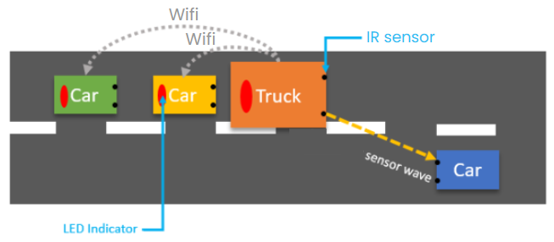
WHAT IT DOES
To prevent accidents during poor visibility, the front car detects oncoming vehicles using IR sensors and instantly shares this info via WiFi to cars behind.
Each car would have an LED light inside it and the message the car receives would be shown via colour.
Red LEDs warn the cars not to overtake; green LEDs signal it's safe. Smart, connected, and safe overtaking made simple.

Slide 8


03.
SDG RELEVANCE
SDG 3: Good Health and Well-Being – Aims to reduce road traffic injuries by preventing overtaking accidents through early detection and alerts.
SDG 9: Industry, Innovation, and Infrastructure – Promotes innovative, tech-driven vehicle communication systems to improve transport safety and infrastructure.

Slide 9
04.
TECHNICAL DETAILS
BUILD OF MATERIALS
IR sensors - to detect the car
Wemos - for wifi communication
Battery - for power supply
RGB LED module - for displaying various colours in one module
Breadboard - for easy connection of wires

Slide 10
THE LOGIC
Sensor positions: One is placed at the right-diagonal-front. The second one is placed on the right side of the body near the rear end.
1.LEDs of Car1 and Car2 are initially set to GREEN.
2. When the diagonal sensor of Car1 detects a car from the opposite side, transmit a message such that LEDs of Car1 and Car2 are RED.
3. Both sensors remain RED. When the diagonal sensor of Car2 detects the opposite car (which would have come forward), the LED of Car1 turns GREEN while the LED of Car2 remains RED.
4. After the opposite car passes the side sensor of Car2, turn the LED of Car2 GREEN.
5. Repeat this logic.

Slide 11
THE CODE
DOCUMENTATION
https://docs.google.com/document/d/1G9fmQCLJxptUjAhOK8bOUPMQRxfNO1UZ/edit?usp=sharing&ouid=107299953370938505535&rtpof=true&sd=true
https://github.com/harshubhasky/Over-Taking-Assistor.git

Slide 12
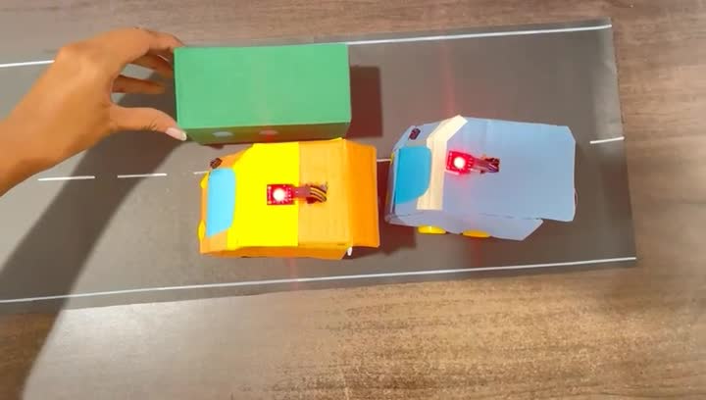
05.
PROJECT EXCECUTION

Slide 13
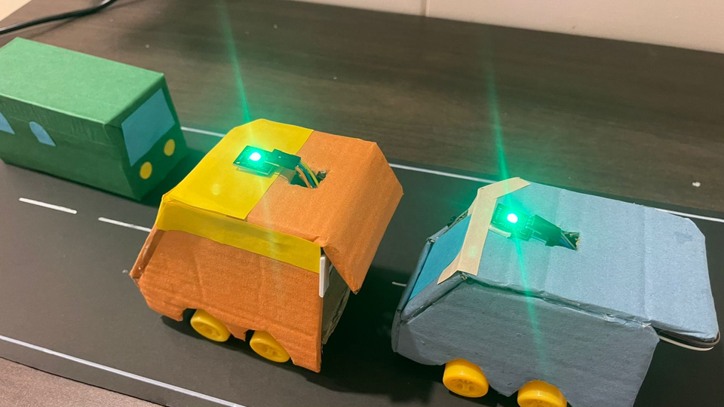
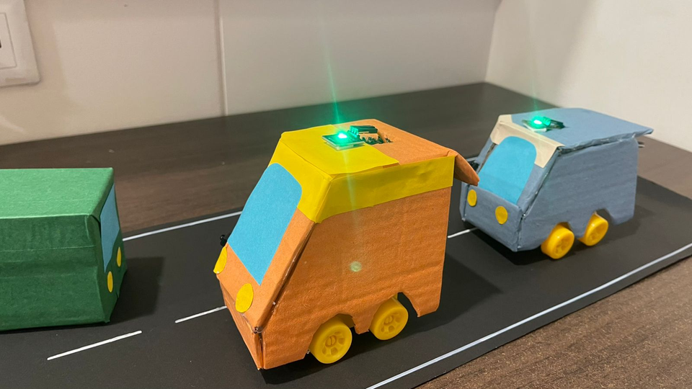
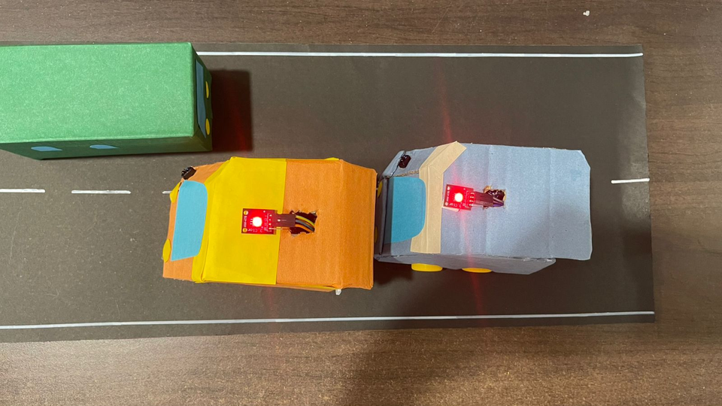
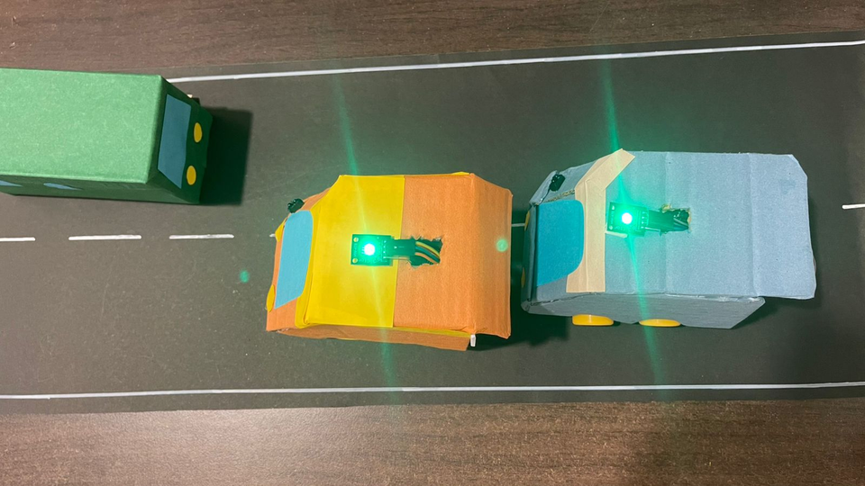
PICTURES

Slide 14
CHALLEGES FACED
There was a lot of discussion and trouble shooting involved. I had initially used different components and had to switch at the last minute.
The entire process was time consuming due to the many errors that occurred but it was all resolved in the end.

Slide 15
06.
PRACTICAL APPLICATIONS
My idea is a concept and would need large scale cooperation to implement in the real world.
This idea could be implemented as an add-on device to a real car, or it could be inbuilt in a car while manufacturing it.

Slide 16
THANK YOU

